Slide 1

Probability and Statistics
AME20213 – Measurements and Data Analysis

Slide 2


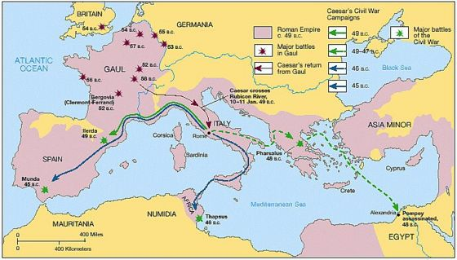
ALEA IACTA EST
“The die is cast!”
Success often hinges on calculated risks.
Julius Caesar, 49 B.C.

Slide 3
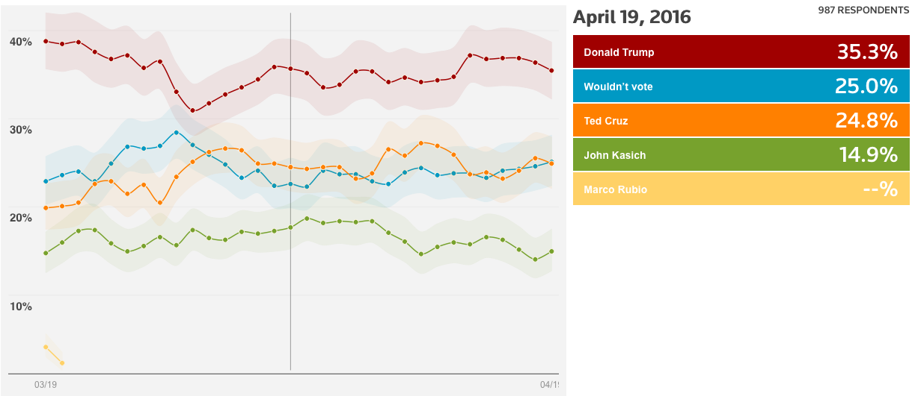
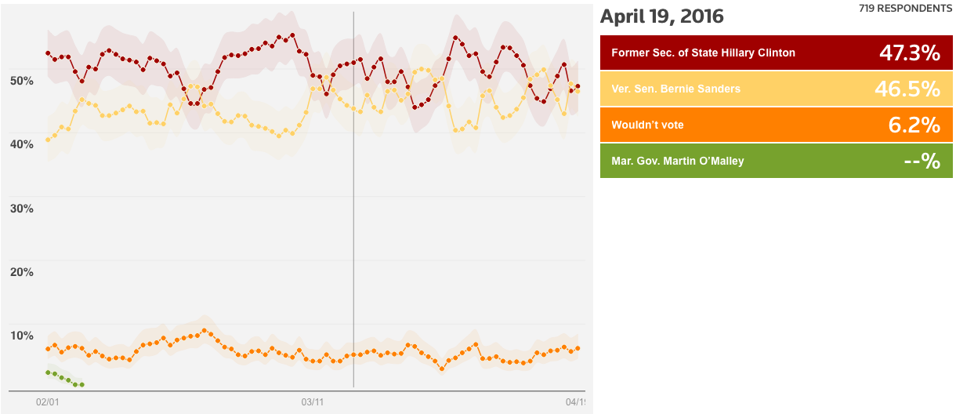
Measuring Probability
N = 987
N = 719
http://polling.reuters.com/

Slide 4

Measuring Probability

Slide 5
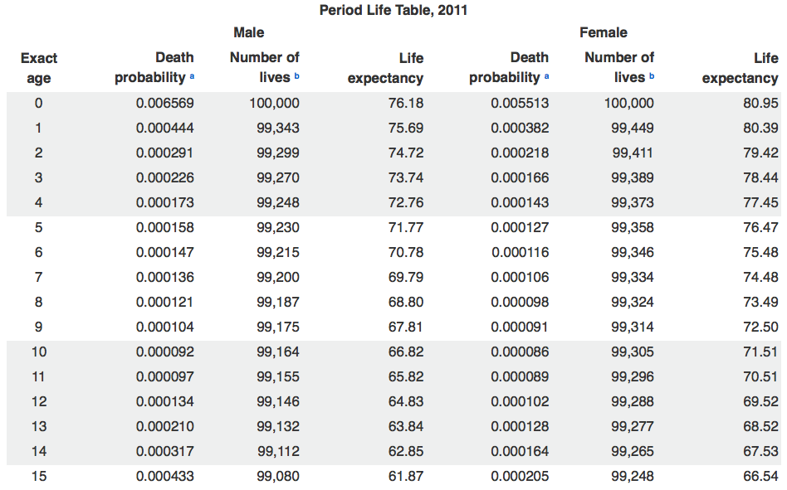
Actuarial Science and Public Policy
https://www.ssa.gov/oact/STATS/table4c6.html

Slide 6
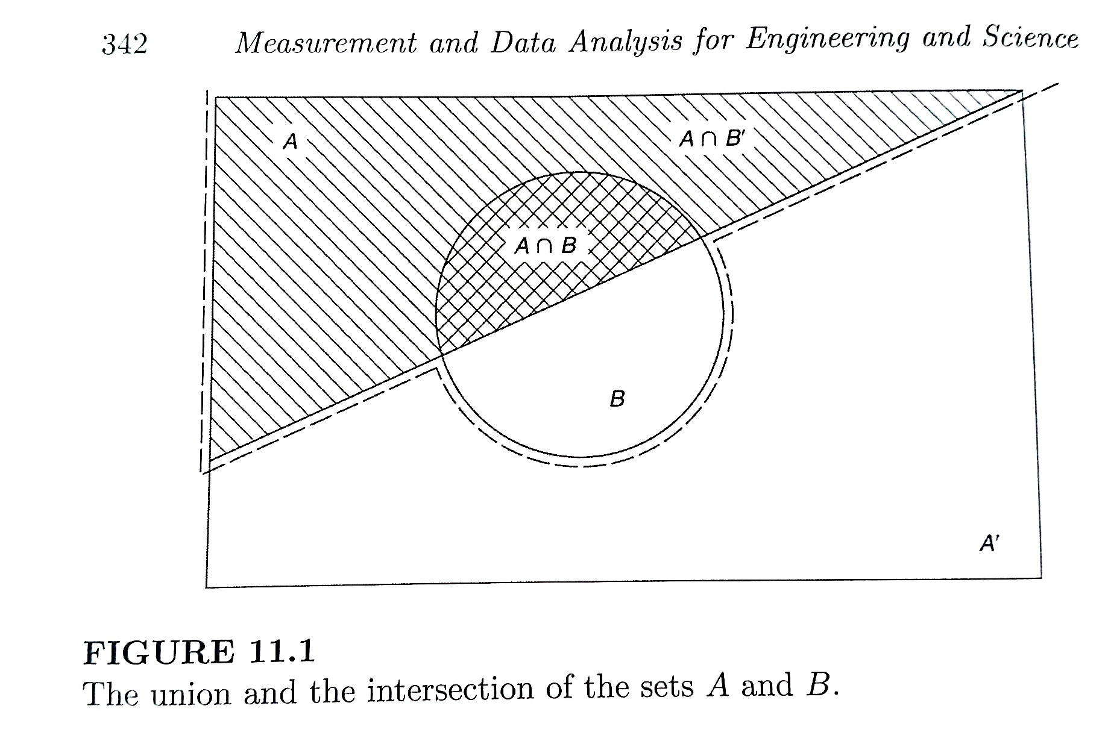
Probability – Venn Diagrams
Intersection “AND”
Union “OR”

Slide 7


Monte Carlo Calculations
Consider taking random shots at this board.
Counted N = 20,857 bullet holes
Probability of landing in the circle:
Measured
π = 3.132
arXiv:1404.1499v2

Slide 8
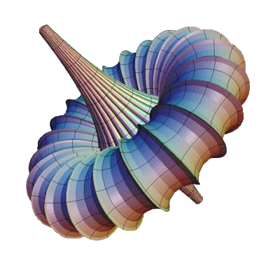
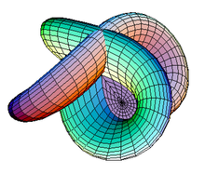
Monte Carlo Calculations
Often used to numerically evaluate complex integrals.
i.e. What’s the volume enclosed in these surfaces?

Slide 9
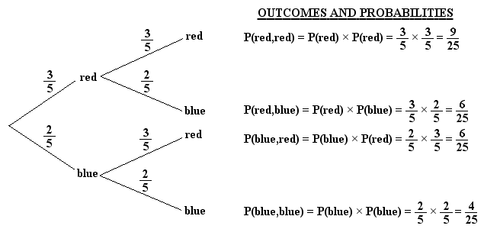
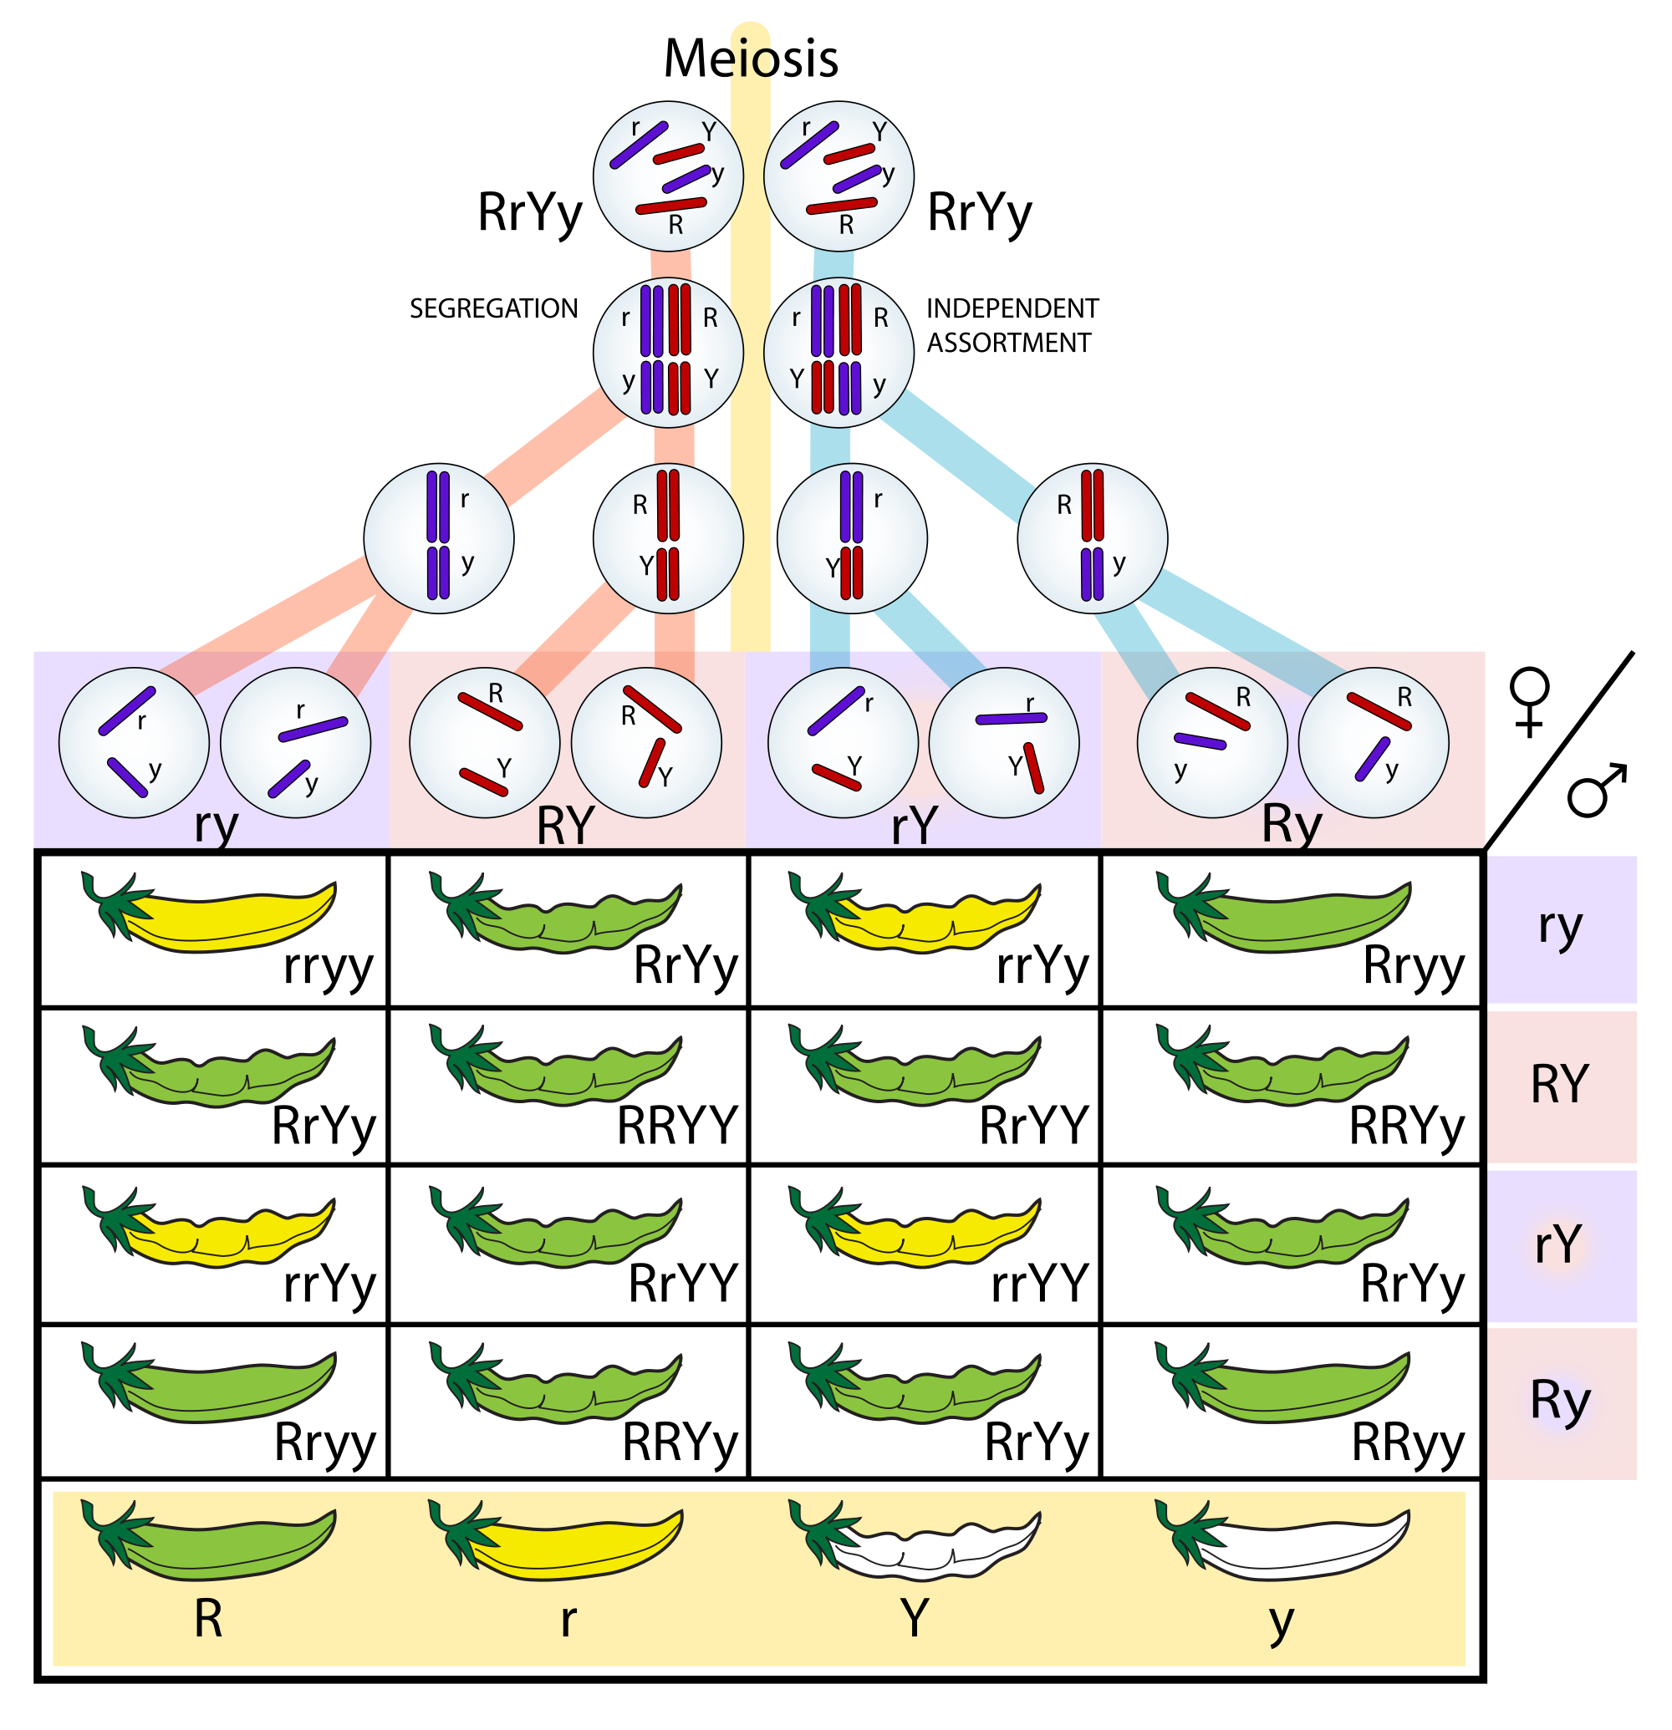
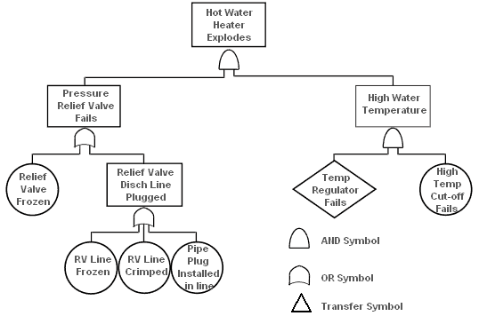
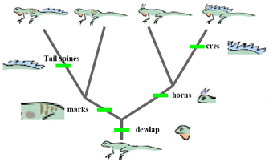
Probability Trees
Genetics
Fault Tree Analysis
Evolutionary Biology

Slide 10

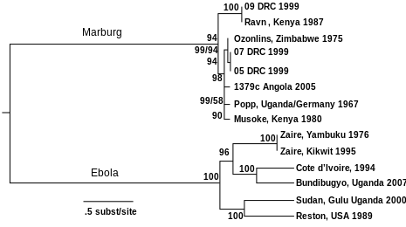
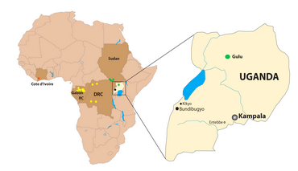
Genetics and Epidemiology
Genetic Sequencing: Future Medicine
Human genetic sequence consists of over 3 billion base pairs: Big data!
Epidemiology – Scientists can monitor the mutations and evolution of diseases in real time.
http://dx.doi.org/10.1371/journal.ppat.1000212

Slide 11

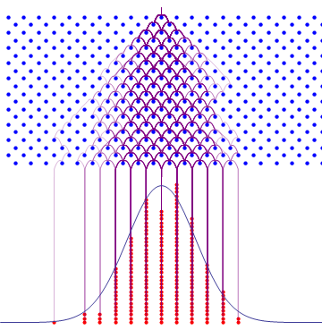

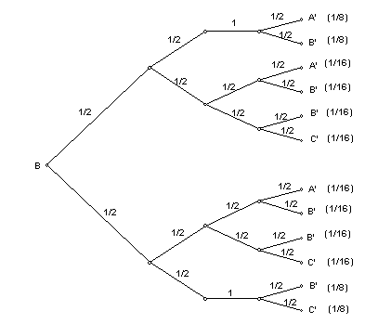
Probability Trees
“Plinko” Game
Random Walk
“Drinko” Game

Slide 12
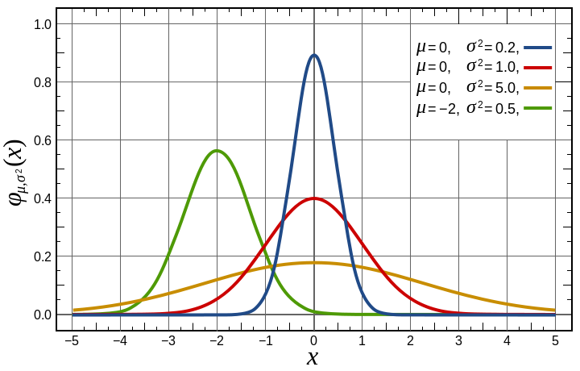
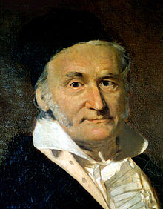
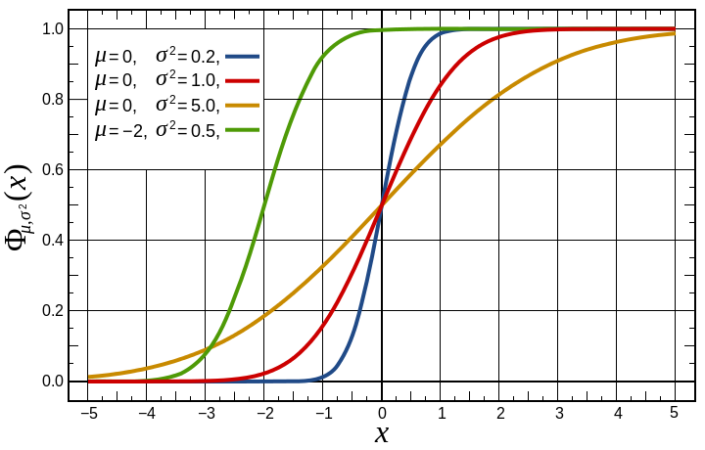
Gaussian Distribution
Gaussian PDF
Central Limit Theorem – For large N, most distributions become Gaussian
Gaussian CDF
Carl Friedrich Gauss (1777-1855)

Slide 13
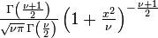
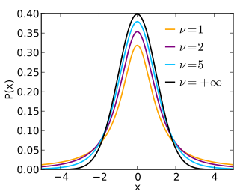
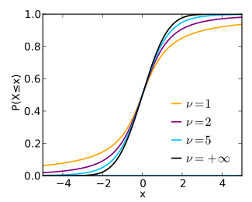
Student’s t distribution
Need to use this if N < 50
Shorter and wider than Gaussian PDF
PDF

Slide 14
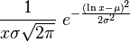
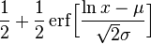
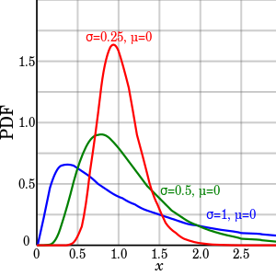
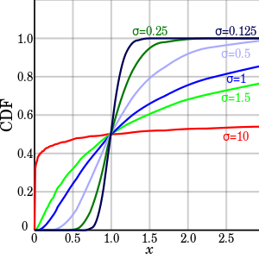
Log-normal Distribution
Used when distribution has a boundary near the mean.

Slide 15
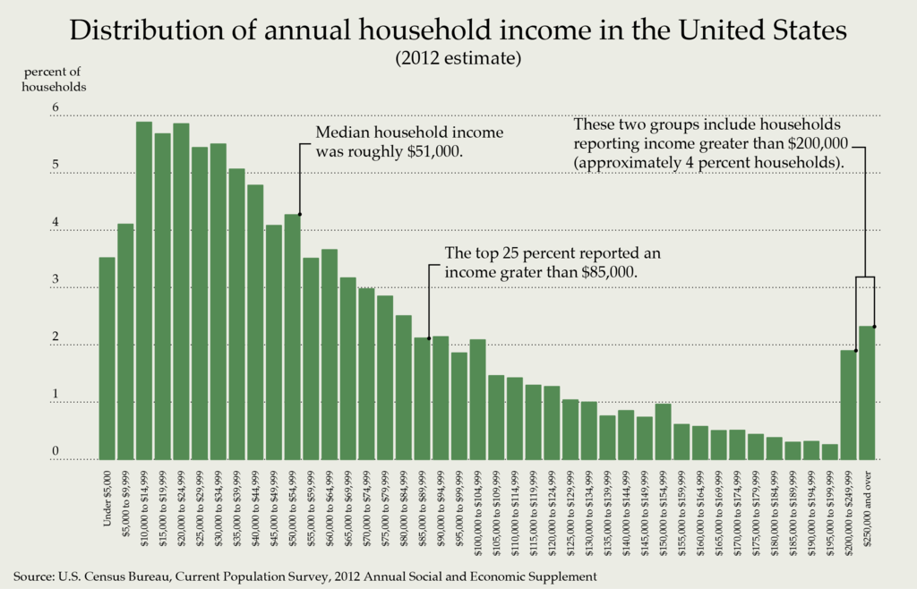

Slide 16
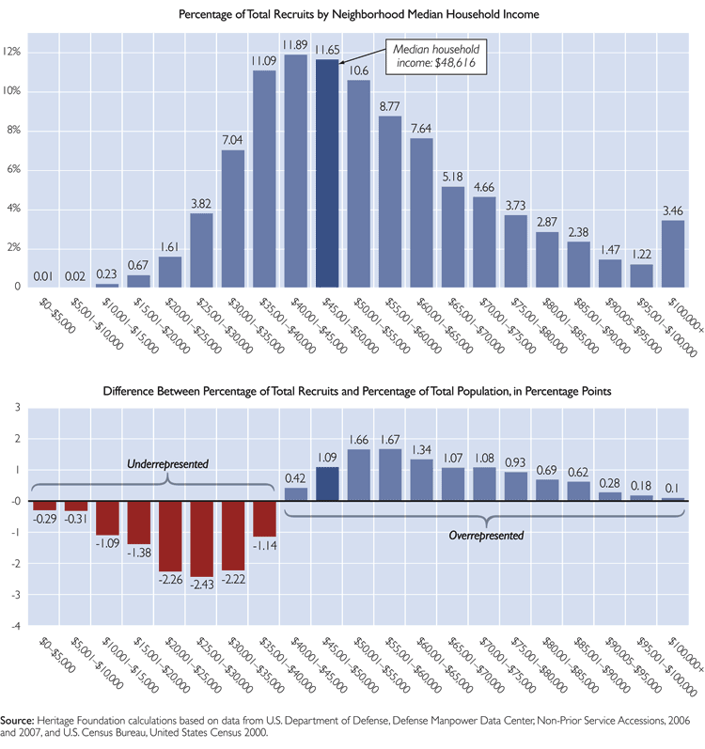

Slide 17
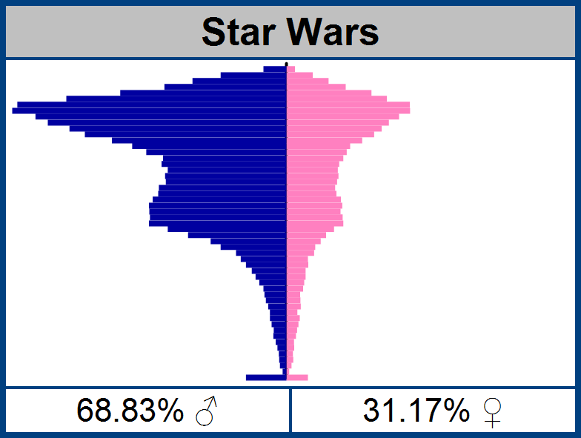
“Bimodal” distribution

Slide 18
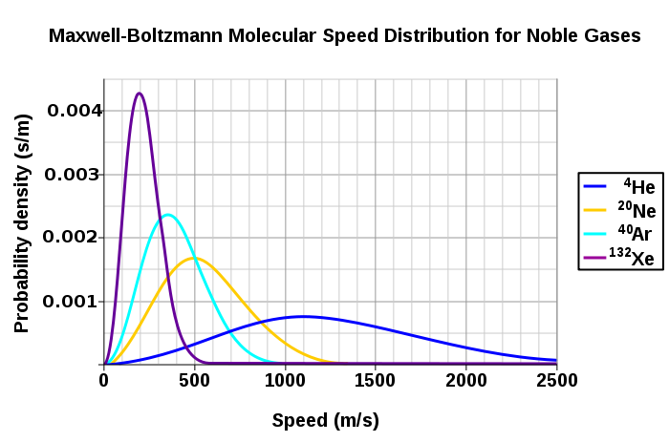
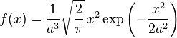
Statistical Mechanics
“Maximum entropy” distribution

Slide 19
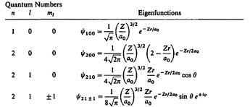
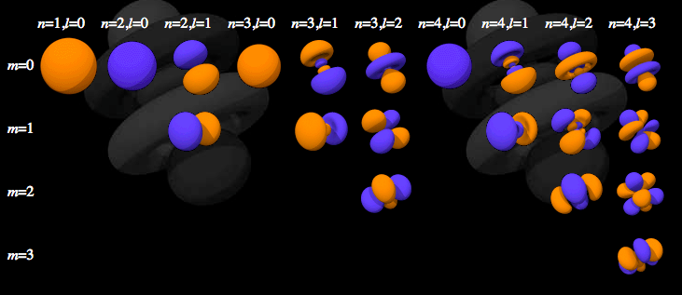
Electron Orbitals
Electron orbitals are also probability density functions
(probability per unit volume)

Slide 20
Other Courses in Probability
AME50561 – Reliability in Engineering (Ovaert)
ACMS10145 – Stats for Business I
ACMS20340 – Statistics for Life Sciences
ACMS30530 – Intro to Probability
ACMS30540 – Mathematical Statistics
ACMS30600 – Stat Methods & Data Analysis
ACMS37020 – Projects in Actuarial Science
ACMS40875 – Stat Methods in Data Mining
MATH40210 – Basic Combinatorics

